Slide 1

Nursing Information Session
Grayson College Nursing Department
Information for Fall 2020 & Spring 2021 Admission Periods

Slide 2
Health Science Advising Office
Jennifer Hill
Health Science Admissions & Advising Office Administrative Assistant
903-415-2520
hillj@grayson.edu
General Program Information
Application Information
Becki Rathfon
Health Science Admission & Advising Specialist
rathfonb@grayson.edu
https://advisingcounseling.as.me/BeckiRathfon
Appointment Hours M-F 2pm-4pm
Walk-In Hours M-F 9am -11:30am
Cassandra Tovar
Health Science Admission & Advising Specialist
tovarc@grayson.edu
https://advisingcounseling.as.me/CassandraTovar
Appointment Hours M-F 9am -11:30am
Walk-In Hours M-F 2pm-4pm

Slide 3
Information Packet
Please email nursing@grayson.edu to request the Information Packet for the nursing program of your choice (Associate Degree Nursing (ADN) or Transitional Entry (LVN-RN) if you have not already done so.
The information packet contains the application needed to apply to the selected nursing program and detailed application, eligibility, and admissions requirements.
Applicants must ensure they are reviewing the most up-to-date information packet as policies and procedures are subject to change.
Please note this video is only a BRIEF OVERVIEW of the requirements to apply to a nursing program, for a FULL OVERVIEW of the requirements, applicants must read the entire information packet thoroughly.

Slide 4
Important Deadlines
Fall 2020
January 31st 2020
(Extended to February 28th )
Initial Application Due
Mandatory Orientation in July (accepted & waitlisted applicants only)
May 29th 2020
Updated Transcripts & 2nd optional attempt at HESI due
Spring 2021
May 1st 2020
(Extended to May 31st)
Initial Application Due
Mandatory Orientation in November (accepted & waitlisted applicants only)
September 4th 2020
Updated Transcripts & HESI due

Slide 5
Program Overview
The Associate Degree Nursing Program (ADN)
60 credit hours total (associate degree)
27 academic non-nursing credit hours
    Pre-Requisites & Co-Requisites
33 nursing credit hours
Program length:
4 semester long (16 weeks each)
*not including 27 credit hours of non-nursing courses
The Transitional Entry Program (LVN-RN)
60 credit hours total (associate degree)
11 credit hours awarded for LVN experience
27 academic non-nursing credit hours
    Pre-Requisites & Co-Requisites
22 nursing credit hours
Program length:
3 semester long (16 weeks each)
*not including 27 credit hours of non-nursing courses
Please see information packet for more details

Slide 6
Academic Requirements
Cumulative GPA
All applicants must achieve a 2.5 cumulative GPA or higher at the time that they apply
All transcripts will be used in the GPA calculation, no exceptions
Applicants are encouraged to schedule an advising appointment at least one semester prior to applying to a nursing program in order to have their cumulative GPA calculated. GPA calculations will not be done over the phone or by email
ADN Program
Pre-Requisites
Anatomy & Physiology I
Anatomy & Physiology II
College Algebra or Statistics
Co-Requisites
Microbiology
Composition & Rhetoric I
General Psychology
Lifespan Growth & Development
Core Elective (Creative Arts/Philosophy/Language/Culture)
LVN-RN Program
Pre-Requisites
Anatomy & Physiology I
Anatomy & Physiology II
College Algebra or Statistics
Microbiology
Composition & Rhetoric I
General Psychology
Lifespan Growth & Development
Co-Requisites
Core Elective (Creative Arts/Philosophy/Language/Culture)
Please see information packet for more details

Slide 7
Application Process
Submit Application
  Required Documents:
    Application Page (pg. 15 for ADN, pg. 16 for LVN-RN)
    Signed Verification Statement (pg. 16 for ADN, pg. 17 for LVN-RN)
    Unofficial College Transcripts, including Grayson College, if applicable
    Eligible HESI admissions exam scores
    Immunization Records
LVN-RN applicants must also include other documents, including but not limited to VN license with license number & letter from employer.
Applications must be submitted as ONE PDF File to nursingadmissions@grayson.edu by the initial deadline per admissions period. All documents must be scanned, no pictures or screenshots accepted.
Tips:
Applicants must fill out entire Application Page
Applicants must provide a handwritten signature on Verification Statement
Applicants must include an up-to-date unofficial transcript per institution attended (including Grayson College Transcripts). Advisor Reports are not acceptable.
Applicants must submit initial eligible HESI scores but can submit a second attempt at the HESI (see deadlines – extended for Spring 2021 applicants only to final deadline)
Applicants can initially submit partial immunization records. Must be able to complete all immunization requirements before the start of the program.

Slide 8
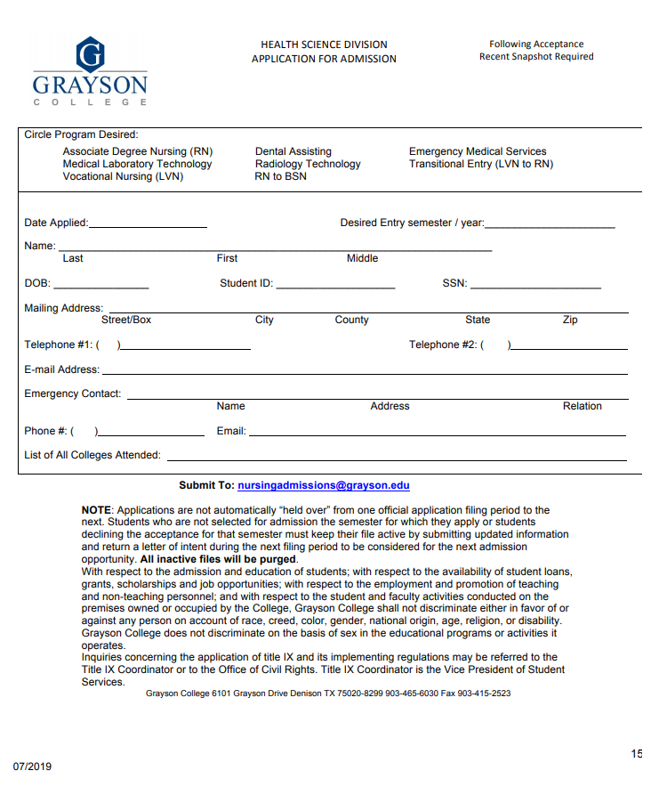
1. Application Page
Tips:
Page 15 for ADN and page 16 for LVN-RN
Fill out entire page
Select program of choice (only one)
Use current mailing address
Use legible handwriting or type in information
Check email address provided frequently for correspondence from our office or the Texas Board of Nursing
This information will be used to initiate your background check, please use current and accurate information!

Slide 9
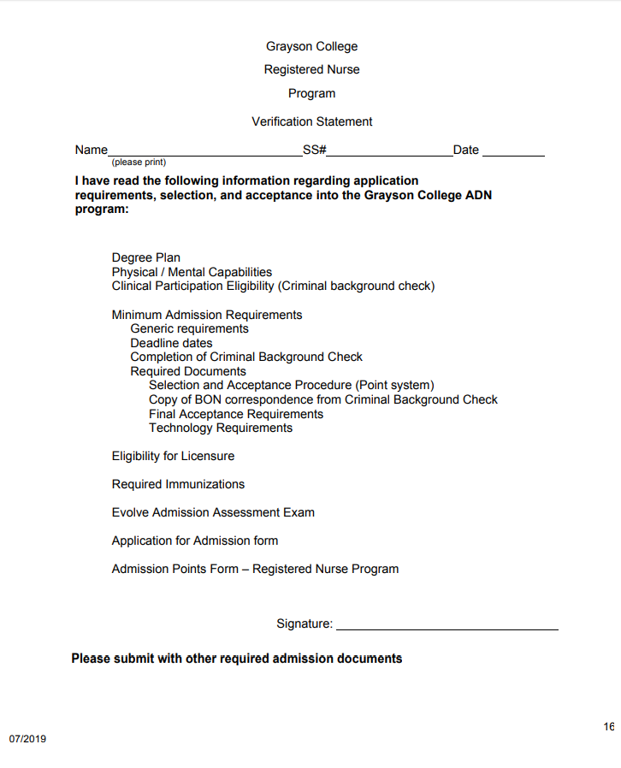
2. Verification Page
Tips:
Page 16 for ADN and page 17 for LVN-RN
Fill out entire page
Use legible handwriting or type in information
Must handwrite signature, no typed signatures accepted

Slide 10

3. Transcripts
Applicants must include a current and legible transcript from each institution attended in their initial application
Transcripts with faded documents, missing pages, missing cumulative GPA, and/or missing important dates will not be accepted
Advisor reports are not accepted
Pictures or screenshots of transcripts will not be accepted
LVN-RN applicants must include LVN transcripts
It is highly encouraged to have your transcript evaluated prior to applying to a program in order to ensure course equivalency and transferability (especially for out of state institutions)

Slide 11
4. HESI A2 Admissions Test
Reading
Grammar
Vocabulary
Anatomy & Physiology
Math
5 Required Sections, scores valid for 5 years
Maximum of 2 attempts at all 5 sections in a 12-month period
Highest score from each section will be used to calculate average score
Points will be awarded based on average score of the 5 sections
HESI test can be taken at any testing center
Please see information packet for more details

Slide 12
5. Immunization Records
TDAP
MMR
Varicella
Influenza
Hepatitis B
Meningitis*
6 Immunizations Required
Titers accepted for MMR, Varicella, & Hepatitis B
Partial records can be submitted with the initial application, but applicants must be able to complete all immunization before the start of the program
Applicants must keep their files up to date by submitting missing immunizations throughout the application process as ONE PDF File to nursingadmissions@grayson.edu
Other health documents will be needed if accepted or waitlisted
Please see information packet for more details

Slide 13
Points Chart
28 points total
SCIENCE COURSES
(up to 18 points total)
OTHER COURSES
(up to 5 points total)
HESI SCORES
(up to 3 points total)
RESIDENCY
(2 points if applicable)
Points Calculation
Points are deducted for science courses attempted multiple times (including withdrawals and failing grades)
All courses must be completed by the 2nd and final deadline in order to apply to the points calculation
Applicants must submit a written request for a waiver for each science course attempted more than 3 times
Points are awarded for the average of all five required sections of the HESI admissions test. The highest score per section of the HESI admissions test is used.
Residency points are awarded to applicants residing in Grayson, Bryant, Fannin, or Marshall county
Please see information packet for more details

Slide 14
Waiting Period
After submitting an application, applicants must check their emails regularly for updates and correspondence regarding program requirements (such as the background check process)
Applicants should not expect reminders for missing documents at any point throughout the application period
Applicants must schedule advising appointments if they would like information regarding a submitted application (such as missing documents)
Applicants must ensure any documents submitted to our office have been received before pertinent deadlines
Submit Application
Maintain an updated file
Finalize the Background check process
Wait for admissions decision

Slide 15
Background Check Process
Upon submission of eligible application, all applicants will be notified of the background check process
Background checks are initiated using the demographic information obtained from the Application Page
The students will be notified via email from Identogo if they are required to undergo fingerprinting. See information packet for more details.
The Texas Board of Nursing will mail NCLEX clearance documents to applicants. Allow up to 8 business weeks for the BON to process your fingerprints & mail the documents from the time of your fingerprinting appointment.
FYI: It is very common to be selected for fingerprinting if an applicant has never undergone a background check through a nursing program
FYI: If an applicant has undergone a background check and previously received NCLEX clearance documents, they can submit those with their application

Slide 16
Admissions & Selection Process
The nursing class will be selected after the 2nd and final deadline per admissions period
The Grayson College Nursing Department admits up to 60 students for the ADN program every Fall and Spring & up to 20 students for the LVN-RN every Fall and Spring.
All applicants are notified via email of their admissions decision
All applicants are required to submit a letter of intent & additional documents in addition to their admissions decision with a deadline for submission (see information packet for more details)
Accepted and waitlisted applicants will be required to attend a mandatory 1-day orientation session on the Main Campus
Any applicants who fail to provide admissions decision documents by the deadline FORFEIT their position on the acceptance or waitlist

Slide 17
Thank You for Watching!
Please email nursing@grayson.edu for additional information or to request the information packet.
We look forward to connecting with you!

