Slide 1
Dental Assisting Information Session
Grayson College Dental Assisting Program
Information for Fall 2020 Admissions Period

Slide 2
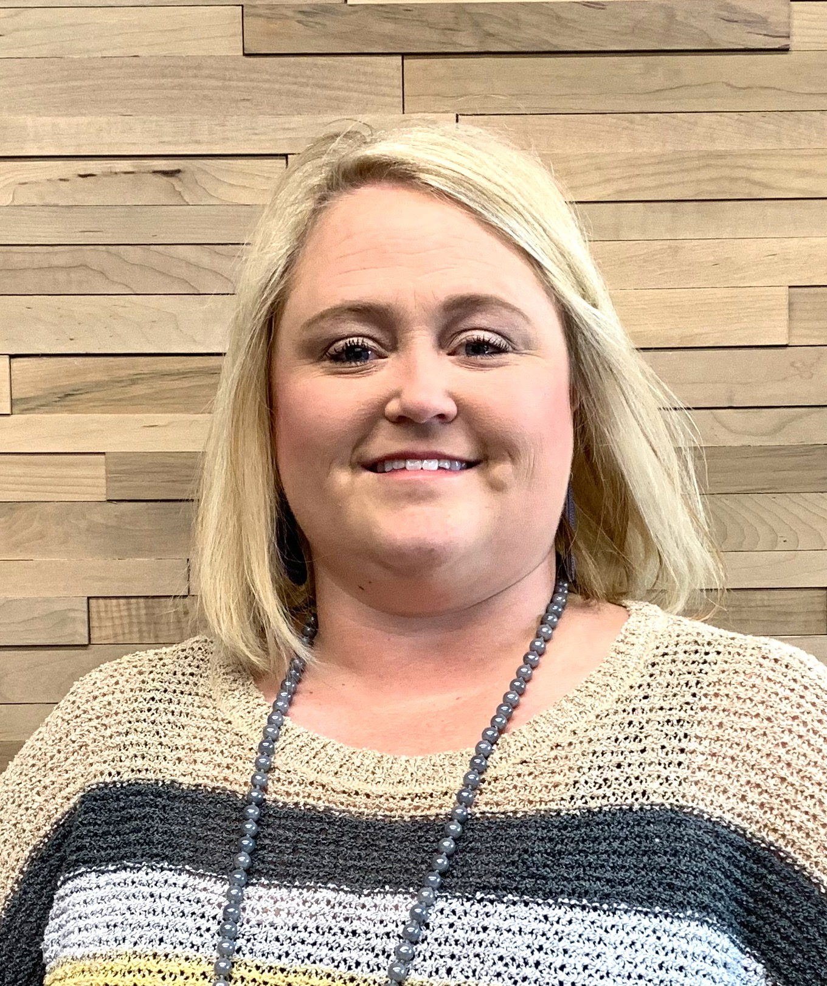
Health Science Advising Office
Jennifer Hill
Health Science Admissions & Advising Office Administrative Assistant
903-415-2520
hillj@grayson.edu
Application Information
Becki Rathfon
Health Science Admission & Advising Specialist
rathfonb@grayson.edu
https://advisingcounseling.as.me/BeckiRathfon
Appointment Hours M-F 2pm-4pm
Walk-In Hours M-F 9am -11:30am
Cassandra Tovar
Health Science Admission & Advising Specialist
tovarc@grayson.edu
https://advisingcounseling.as.me/CassandraTovar
Appointment Hours M-F 9am -11:30am
Walk-In Hours M-F 2pm-4pm
Tonya Hance, Program Director
Program Related Questions
hancet@grayson.edu

Slide 3
Information Packet
Please email dental@grayson.edu to request the Information Packet for the dental assisting programs if you have not already done so.
The information packet contains the application needed to apply to the selected dental program(certificate or associate’s program) and detailed application, eligibility, and admissions requirements.
Applicants must ensure they are reviewing the most up-to-date information packet as policies and procedures are subject to change.
Please note this video is only a BRIEF OVERVIEW of the requirements to apply to the Dental Assisting program, for a FULL OVERVIEW of the requirements, applicants must read the entire information packet thoroughly.

Slide 4
Programs Overview
The Grayson College Dental Assisting Department offers two dental programs:
✓Certificate
✓Associate
Both programs admit students in the Fall semester only
Both programs require an application submission for consideration into the program

Slide 5
Fall 2020 Important Deadlines
March 1st
Application Opens
August 1st
Priority Deadline
August 24th
1st Day of Class

Slide 6
Dental Assisting Certificate
Pre-Requisites
Composition & Rhetoric I (3 Credit Hours)
General Psychology (3 Credit Hours)
*Must have prior to starting the program
Fall 2020 (1st Semester)
16-week term
16 Credit Hours
Spring 2021 (2nd Semester)
16-week term
17 Credit Hours
Spring 2021 Mini
Short 3-week term
2 Credit Hours

Slide 7
Dental Assisting Associate
Pre-/Co-Requisites
8 classes total
25 credit hours
*Two courses must be achieved before applying to program (ENGL1301 & PSYC2301)
*All courses must be completed before applying to graduation
Fall 2020 (1st Semester)
16-week term
16 credit hours
Spring 2021 (2nd Semester)
16-week term
17 credit hours
Spring 2021 Mini
Short 3-week term
2 credit hours

Slide 8
Application Process
Apply to Grayson College & be fully admitted to the College
www.grayson.edu
Submit Program Application
To dental@grayson.edu
All unofficial transcripts, including High School &/or College
College Placement Scores (ex. TSI, ACT, SAT, etc)
Immunization Records
All applicants must have a cumulative GPA of 2.0 or higher
Application Form (page 8)
Drug Screen Consent Form

Slide 9
Admission & Selection
Dental Assisting Department admits a class of up to 24 students every Fall semester
All applicants will be ranked in order of most academically prepared
Department will email all applicants their admissions decision
Priority is given to applications submitted by June

Slide 10
Acceptance Documents
When an acceptance letter is received, instructions for the following will be included in the letter:
TB test to be completed and documentation turned in prior to FIRST DAY OF CLASS.
CPR Certification for BLS Healthcare Provider (American Red Cross or American Heart Association) must be completed prior to FIRST DAY OF CLASS.
Dental Examination must be completed prior to FIRST DAY OF CLASS.
Pass a urine drug screen
Pass a criminal background check.

Slide 11
Thank You for Watching!
Please email dental@grayson.edu for additional information or to request the information packet.
We look forward to connecting with you!

