Slide 2
INTRODUCTION OF NEW EMPLOYEES

Slide 3
STUDENT SERVICES
Kathleen Boatright, Admissions Specialist
Tomyra Britt, Director of SSS
Lewanda Diaz, Success Coach
Jayce Randolph, Residence Hall Supervisor
Kinzie Randolph, SSS Advisor
Caleb Reed, Financial Aid Advisor II

Slide 4
STUDENT SERVICES
Claudia Smithart, Counselor
Audra Talley, Residence Hall Supervisor
Cassandra Tovar, Financial Aid Advisor
Avery Wageman, Admissions Specialist
Alan Zhang, Recruiter

Slide 5
INSTRUCTION
Amanda Boyle, Associate Degree Nursing Professor
Margo Carr, Math Hub Coordinator
Erin Conklin, Associate Degree Nursing Professor
Rondie Escamilla, Associate Degree Nursing Professor
Marcus Freeman, Assistant Director of Adult Education

Slide 6
INSTRUCTION
Brittany Fuller, VN Instructor
Hannah Holt, Associate Degree Nursing Professor
Rose Lerma, Librarian
Marlene Phillips, Director of Career Advising & Outreach
Davina Ransom, Assistant Director of AEL

Slide 7
BUSINESS SERVICES
Clayton Pyles, Police Officer

Slide 8
ATHLETICS
Melaney Card, Athletic Trainer
Brandon Taylor, Assistant Women’s Basketball Coach
Omar (OT) Thomas, Assistant Men’s Basketball Coach

Slide 9
EMERGENCY MANAGEMENT UPDATE Chief Kevin Nugent

Slide 10
SACSCOC UPDATE Dr. Debbie Smarr

Slide 11
CARE CLUB

Slide 12
GRATITUDE EXERCISE
What are the notable things that you’re proud of as a member of the Grayson College team?

Slide 13
RECENT PURSUITS
Recent Building Projects
Teaching Distillery
Student Success Center
Student Affairs Building
Health Science Remodel
Environmental Assessment/West Campus Extension
New Programs
RN to BSN
Associate of Science in Agriculture

Slide 14
STRATEGIC PRIORITIES
Build A Welcoming Culture
Transform More Lives
Lean In To Student Success
Remove Barriers

Slide 15
BUILD A WELCOMING CULTURE
Leadership Academy Training
Create Clarity around Student Experience
Knowing Names
Name Badges
Greeter in Student Services During Rush
Scheduling for Success Coaches During Non-Rush Times

Slide 16
TRANSFORM MORE LIVES
Launch Collegiate Academy
Launch Bridge Scholarship
100% Admissions Efforts
New GC Application for Admission
Build Robust Communication Plan
Financial Aid Completion in HS’s
Reinstitute Mandatory Orientation
Maximize Residence Hall Use
Continue Engagement with ISD Partners
Develop True Transfer Partnerships- SB25
Expansion of AEL into Collin County

Slide 17
LEAN IN TO STUDENT SUCCESS
Enhance Student Planner
Enhance College Connections Course
Launch RN to BSN
Clarify Pathways- SB25
Cruise to Completion

Slide 18
REMOVE BARRIERS
Expand College Prep Course in High Schools
Expand Co-Requisite Courses in Math, Reading and Writing
Open Educational Resources Initiative (low-cost books/course resources)
Fresh Start Program (forgiving debt to GC)
Restructure “Holds” on Students
Emergency Aid Support

Slide 19
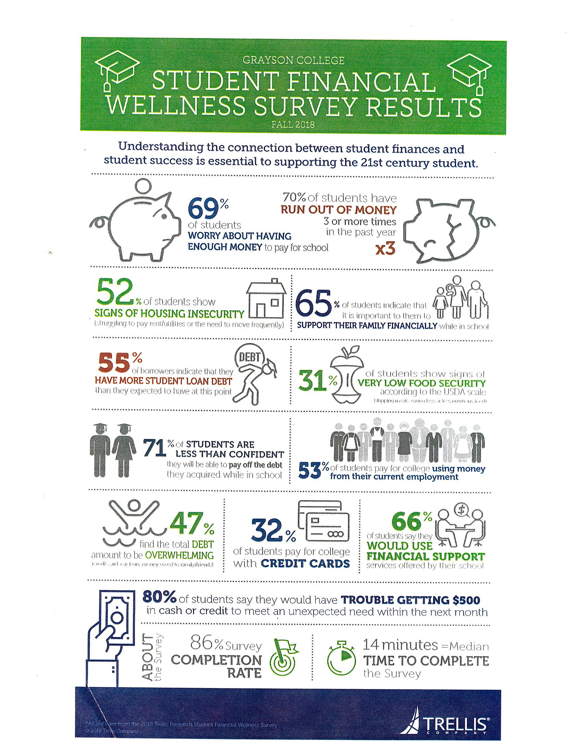
EMERGENCY AID
The GC Student Affairs area reports the needs most commonly requested include transportation assistance, emergency housing and financial assistance.
Resources: Community Partners (TCOG); potentially hire a social worker and/or reorganize to support this work explicitly.

Slide 20
EMERGENCY AID
$25,000 Emergency Aid Fund
Short-Term Housing in Viking Hall
Exploring Enhanced Location of Food Pantry
Pursuing grants for Social Worker
Foster Care Liaison Named
Working to get Social Worker Intern from TAMUC
Point of contact is Barbara Malone

Slide 21
BUDGET
Pay Increases Approved
Additional Faculty/Staff to Support RN/BSN and EMT Programs
Increased Investment in Plant Fund
Decrease Reliance on Bookstore Revenue

Slide 22
ANNOUNCEMENTS
Celebrating 50 Years of Associate Degree Nursing
Celebrating 50 years of the Police Academy
Subscribe to GC Google Calendars
Coffee & Conversation Friday, September 20 at 8:30am

